Slide 1



Hearty Welcome
to
Students
for
12 Day value added course
On
“Deep Learning and Its Applications” – Day 2

Slide 2
So far we have studied
Introduction to AI
Basic concepts of Machine Learning
Types of Machine Learning
Preliminary insight on Deep Learning
Types of data and datasets

Slide 3
Contents
Performance Metrics
Classification
Regression

Slide 4
At the end of the session you will be able to learn:
What is performance metrics.
Different performance metrics for Classification.
Different performance metrics for Regression.

Slide 5
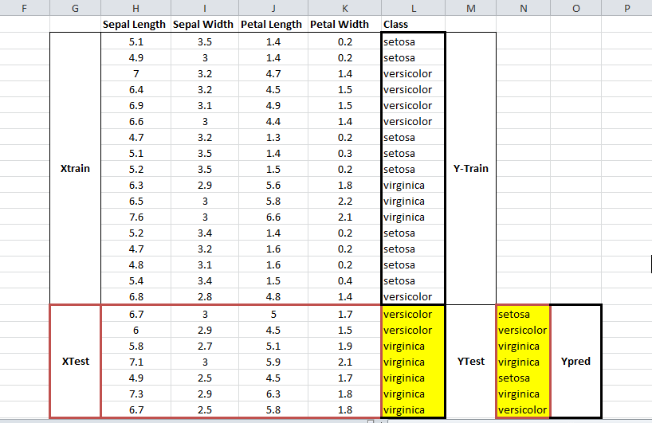
Working of train_test_split

Slide 6
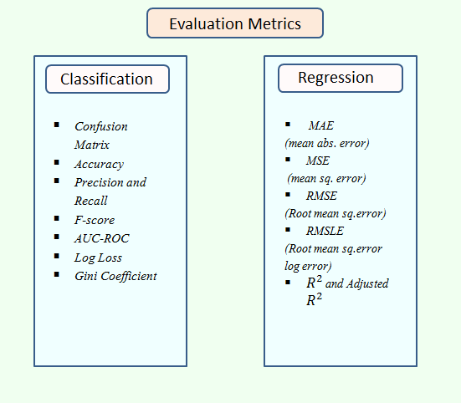
Performance metrics
It basically defined on probability estimates and
measures the performance of a classification model where
the input is a probability value
between 0 and 1.

Slide 7
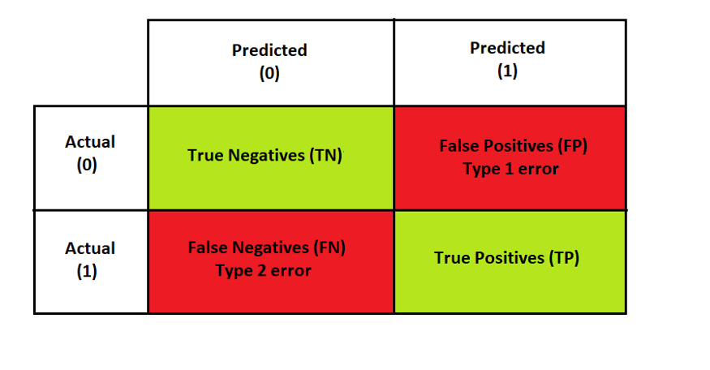
Confusion Matrix for binary classification
True Negatives (TN): The actual value is 0 and the value predicted by our classifier is also 0.
False Positives (FP):
The actual value is 0 but the value
predicted by our classifier is 1
False Negatives (FN): The actual value is 1 but the value predicted by our classifier is 0.
True Positives (TP): The actual value is 1 and the value predicted by our classifier is also 1.

Slide 8
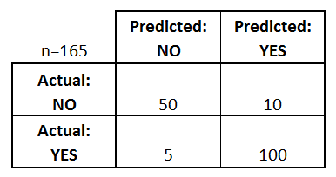
Example
TP = ?
TN =?
FP= ?
FN =?

Slide 9
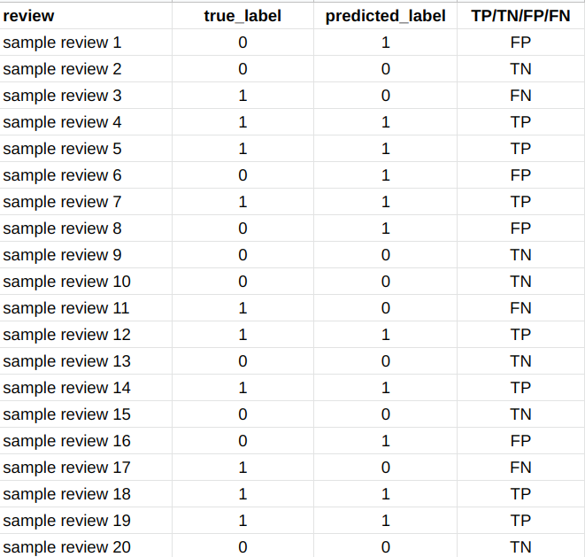
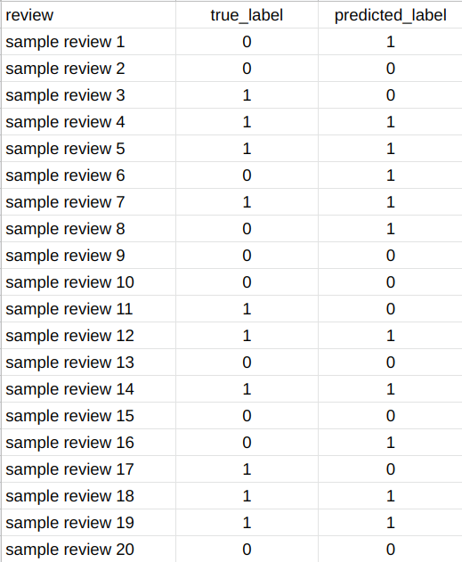
Example

Slide 10
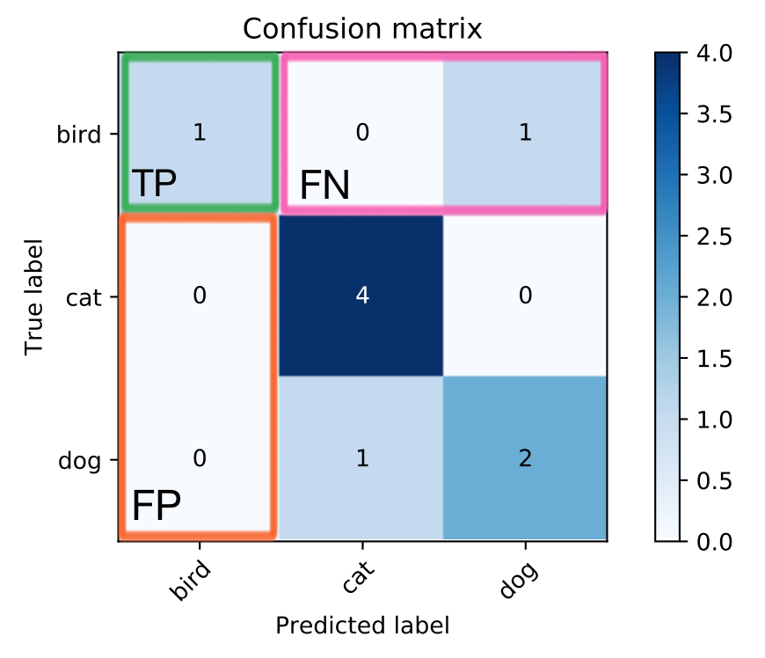
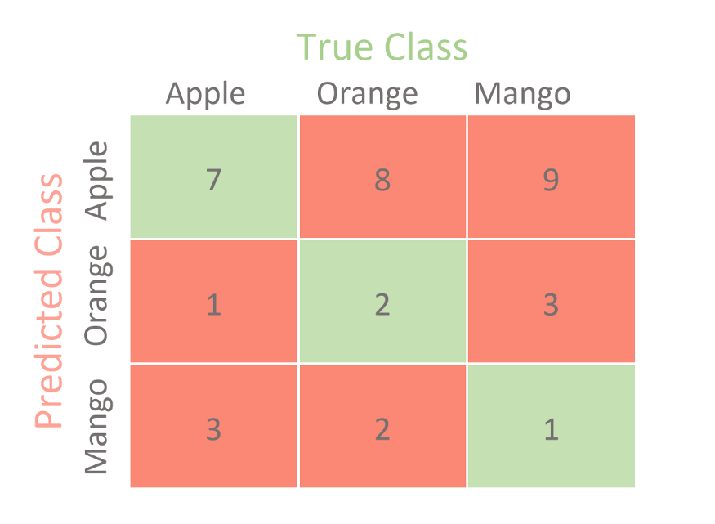
Confusion Matrix for multiclass classification
TP = 7
TN = (2+3+2+1) = 8
FP = (8+9) = 17
FN = (1+3) = 4

Slide 11
Example
The case where a person is actually having cancer(1) and the model classifying his case as cancer(1) comes under True positive.
The case where a person NOT having cancer and the model classifying his case as Not cancer comes under True Negatives.
A person NOT having cancer and the model classifying his case as cancer comes under False Positives.
A person having cancer and the model classifying his case as No-cancer comes under False Negatives.

Slide 12
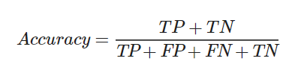
Accuracy
When to use Accuracy:
Accuracy is a good measure when the target variable classes in the data are nearly balanced.
Ex: 60% classes in fruits images data are apple and 40% are oranges.
A model which predicts whether a new image is Apple or an Orange.
When NOT to use Accuracy:
Accuracy should NEVER be used as a measure when the target variable classes in the data are a majority of one class (imbalance dataset).
Ex: In cancer detection example with 100 people, only 5 people has cancer.

Slide 13
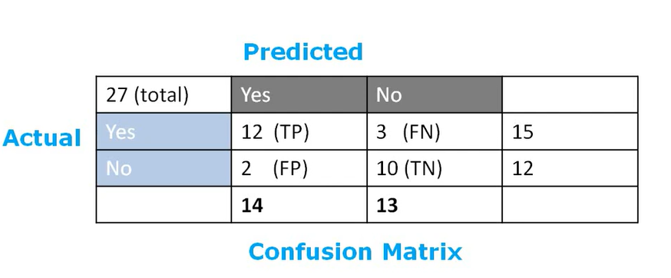
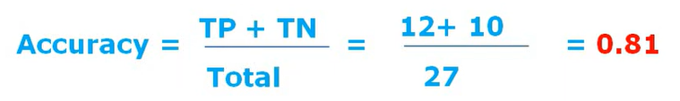

Slide 14
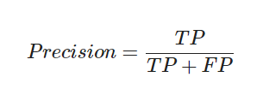
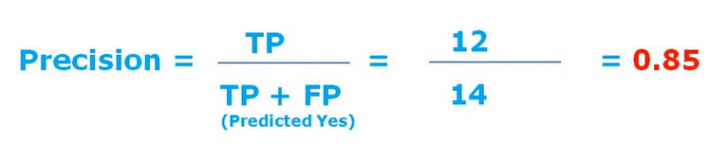

Slide 15

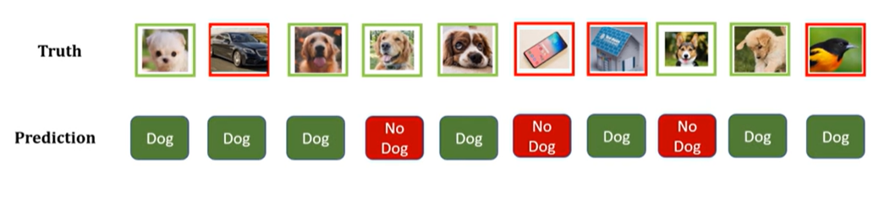
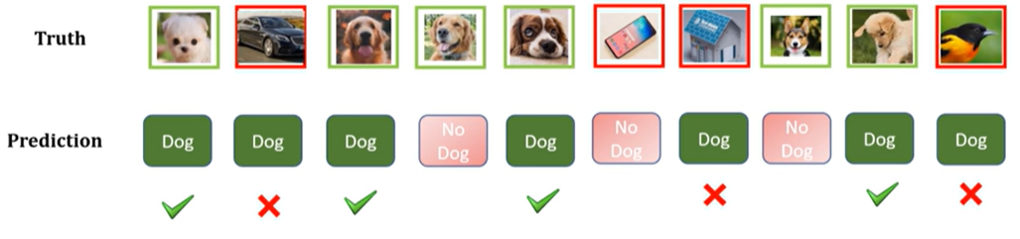
Precision
Out of total predicted positive results, how many results are actually positive

Slide 16
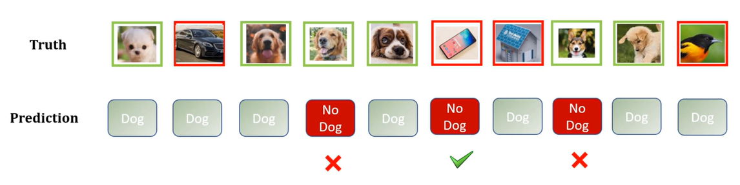



Slide 17
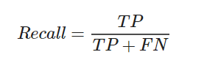
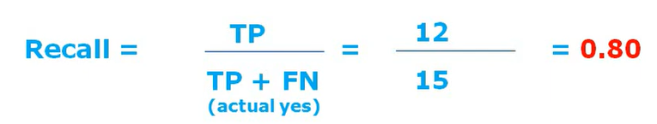

Slide 18

Recall or Sensitivity
True Positive Rate
Out of the total positive actual values, how many values are predicted correctly

Slide 19

False Positive Rate

Slide 20

F1 Score
This score will give us the harmonic mean of precision and recall. Mathematically, F1 score is the weighted average of the precision and recall. The best value of F1 would be 1 and worst would be 0.

Slide 21
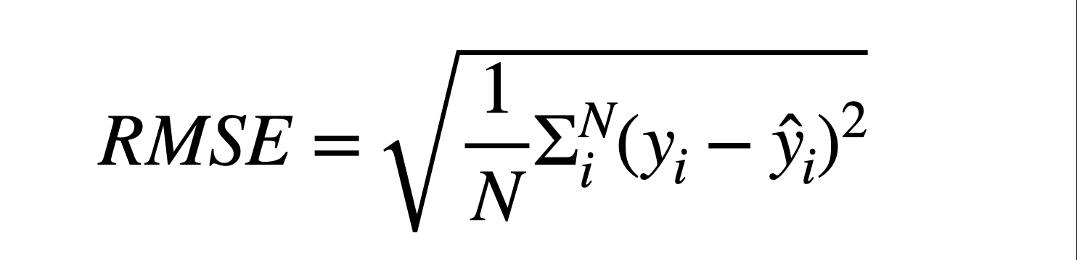



Regression
Mean Squared Error (MSE)
Root Mean Squared Error (RMSE)
Mean Absolute Error (MAE)
Mean Absolute Percentage Error (MAPE)

Slide 22
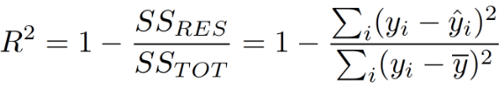
Regression
R-Squared
yi – Actual value
yi hat – predicted value
y dash – average of the model

Slide 23
Example
Actual Value (y) | Predicted Value(y hat) | Error Difference | Absolute error | Square error | Square root
100 | 130 | -30 | 30 | 900 | 900
150 | 170 | -20 | 20 | 400 | 400
200 | 220 | -20 | 20 | 400 | 400
250 | 260 | -10 | 10 | 100 | 100
300 | 325 | -25 | 25 | 625 | 625
 |  | Mean | 21 | 485 | 485 (22.022)

Slide 24
Thank you

